Slide 1
Playing notes by image processing
Dela Cruz, Mary Nathalie G.

Slide 2
Objective: to play a musical scoresheet using image processing

Slide 3
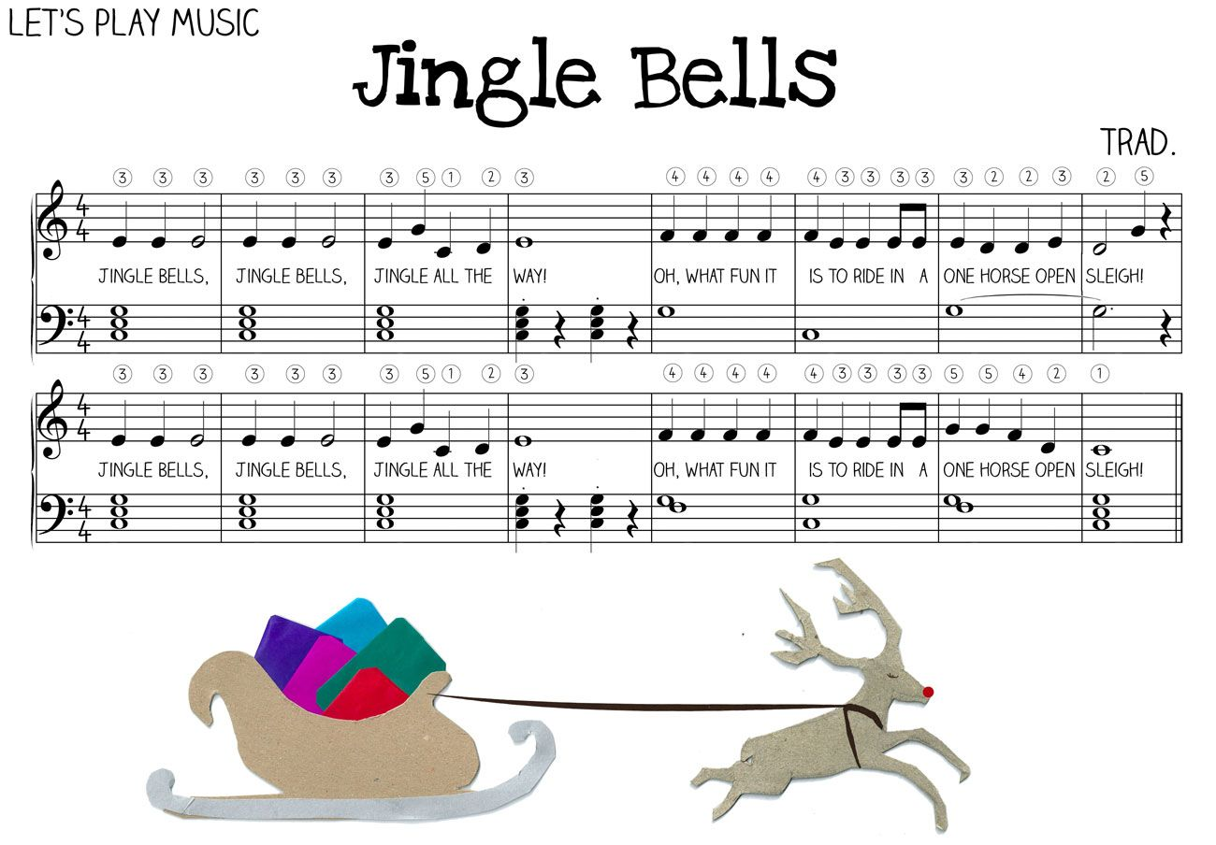
The musical sheet that I chose is “Jingle Bells”.
Fig 1: Musical sheet

Slide 4
Snapshot of the sheet was taken, then the unwanted parts (e.g. lyrics) were cropped and the two lines of the musical sheet were combined and divided by a thick bar, as shown below.
Fig 2: Cropped musical sheet

Slide 5
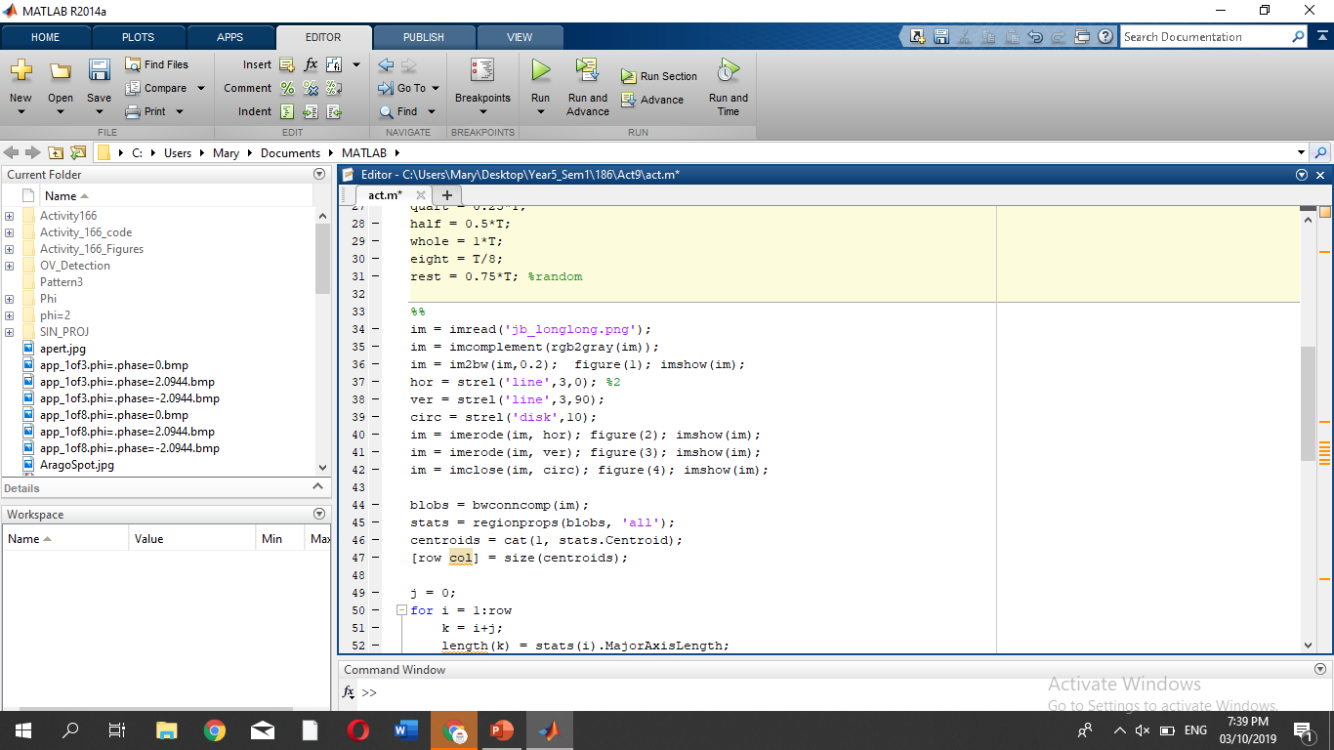
To remove the thin horizontal and vertical lines in Fig 2, the image was eroded with a thin horizontal line and a thin vertical line. This results to the figure shown in Fig 3.
Fig 3: Cropped musical sheet that was eroded

Slide 6
We then enhanced the image using the imclose() function with a circular structure element. It results to Fig 4.
Fig 4: Blobs of the cropped musical sheet were closed.
As shown, the blobs are distinct where the major axis length of the whole note, half note, quarter note, barred eighth note and the thick bar at the center differ.

Slide 7
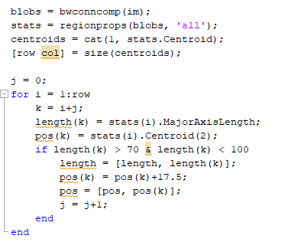
Before differentiating the notes and the bar from each other, the major axis length (length) and the y-coordinate (pos) of the centroid of each blob were taken.
Note that we wanted to separate the eighth notes that were barred and to get the y coordinate of the centroid of each eighth note. This was done during the if statement, where the barred eight note has a major axis length greater than 70 and less than 100.

Slide 8
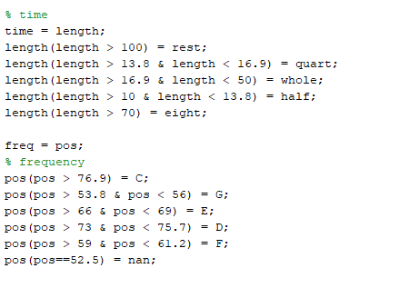
Here, we differentiated each note from the major axis length (length) of the blobs and we identified their pitch from the y-coordinate (pos) of the centroid of the blobs.
Note that the rest and nan in the code were used for the bar that separates the two lines in the musical sheet. This was done so that there is a slight pause in between the two lines.

Slide 9
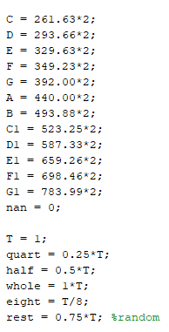
Here are the time durations and the frequencies that were equated in the previous slide.

Slide 10
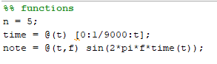
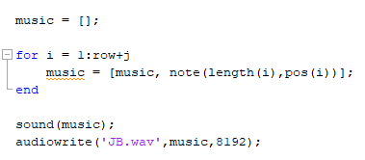
The sound was then produced by defining a time() function that creates an array for time from 0 to time t, a note() function that creates a sinusoid that is dependent on frequency f and time t, and using the built-in matlab function sound().

Slide 11

JINGLE BELL SONG PRODUCED:

